Slide 1
An Agentic Retrieval-Augmented Forecasting Framework for India’s Automotive Market: Integrating Multi-Document Intelligence, Policy Analysis, and Time-Series Modelling
Presenter: Ravikanth Amajala
SRM Institute of Science and Technology
Co‑Author: Dr. K. Venkatesh

Slide 2
Presentation Outline
1. Motivation
2. Research Gap
3. Objectives
4. Proposed Framework
5. System Architecture
6. Forecasting Models
7. Dataset & Experimental Setup
8. Results
9. Contributions
10. Conclusion

Slide 3
Motivation
Accurate automotive demand forecasting is essential for:
• Production planning
• Supply‑chain optimization
• Policy evaluation
• Strategic investment
Traditional models rely mainly on historical numerical data.

Slide 4
Research Gap
Existing forecasting systems:
• Use structured numerical data only
• Ignore policy documents and industry reports
• Provide limited contextual interpretation
This creates a gap between prediction models and real-world market decisions.

Slide 5
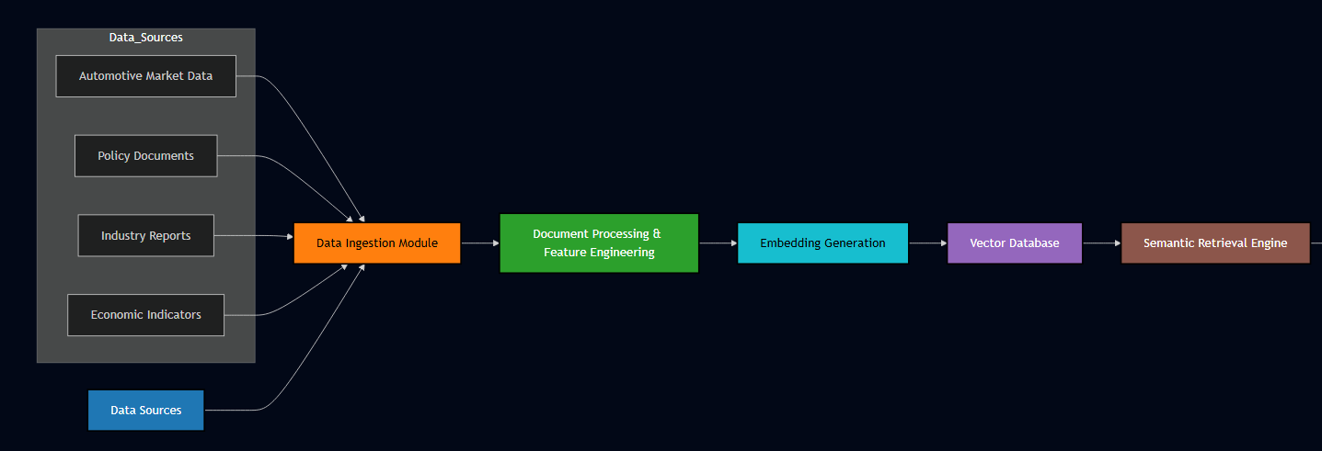
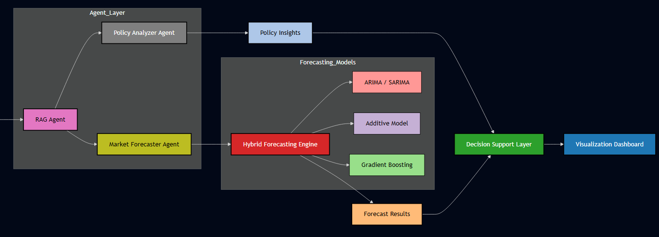
Proposed Solution
Agentic Retrieval‑Augmented Forecasting (ARAF)
Key Idea:
• Combine time‑series forecasting
• Integrate policy and industry document intelligence
• Use AI agents for reasoning
Output: Forecast + policy-aware explanation

Slide 6
System Architecture
Framework Modules:
1. Data Ingestion – datasets & policy reports
2. Document Processing – chunking & embeddings
3. Semantic Retrieval – relevant policy context
4. Agent Processing – forecasting & analysis
Enables knowledge‑grounded forecasting.

Slide 7
Forecasting Models
Hybrid forecasting strategy:
• ARIMA / SARIMA – temporal trends & seasonality
• Additive Model – trend and seasonal effects
• Gradient Boosting (XGBoost) – nonlinear patterns
Hybrid approach improves prediction robustness.

Slide 8
Dataset & Experimental Setup
Dataset characteristics:
• Time span: 2014–2024
• Observations: 132 monthly data points
• Policy documents: 148
• Embedding chunks: 2436
Forecast horizons: 1, 3, 6, 12 months

Slide 9
Results
Model Comparison (MAE):
• ARIMA: 6425
• Additive Model: 9152
• XGBoost: 10112
• Hybrid Proposed Model: 5982
Hybrid approach achieved the best forecasting accuracy.

Slide 10
Conclusion
Key Outcomes:
• Policy‑aware forecasting framework
• Improved prediction accuracy
• Interpretable decision‑support insights
Future Work:
• Scenario simulation
• Cross‑industry forecasting
Thank You – Questions?

Slide 11
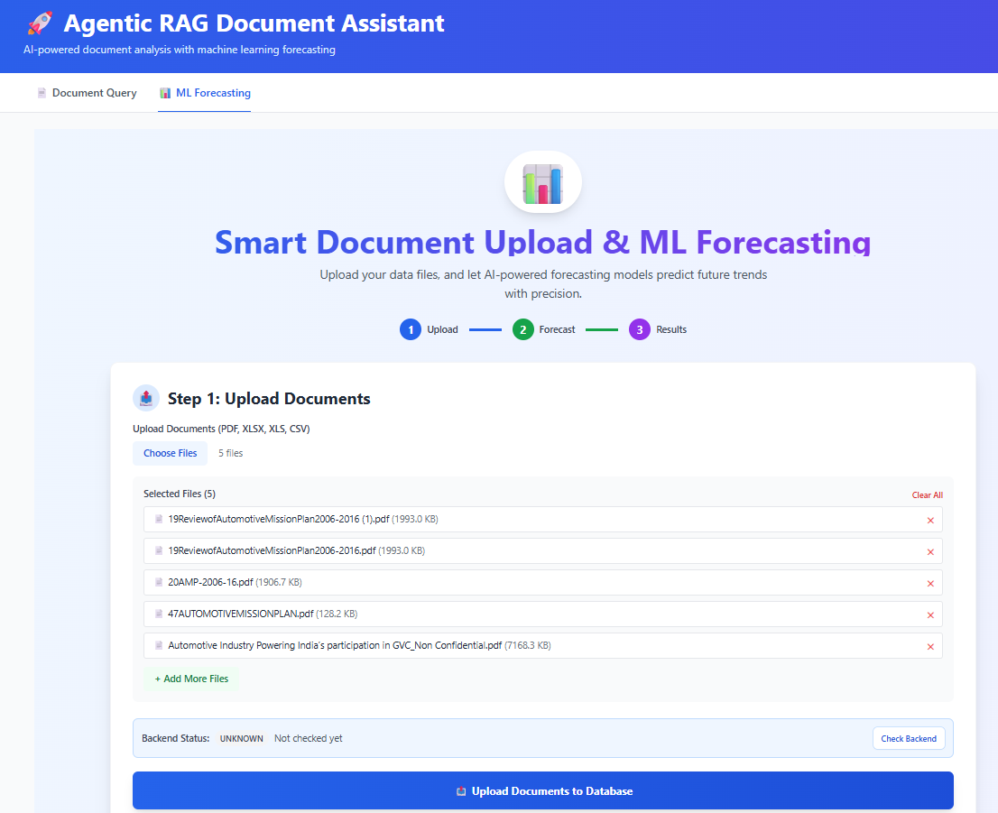

Slide 12
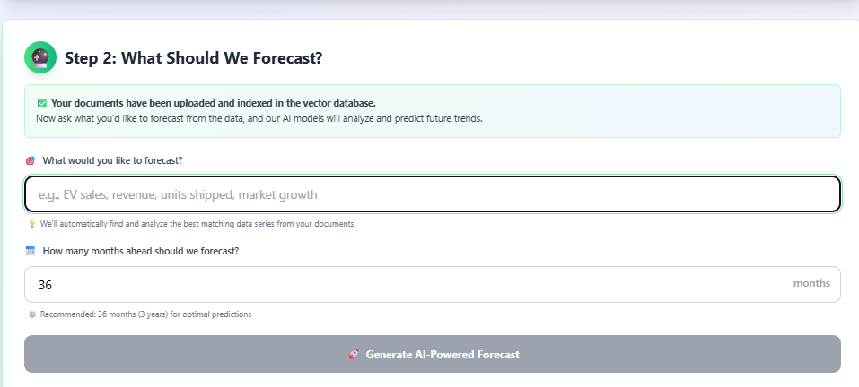
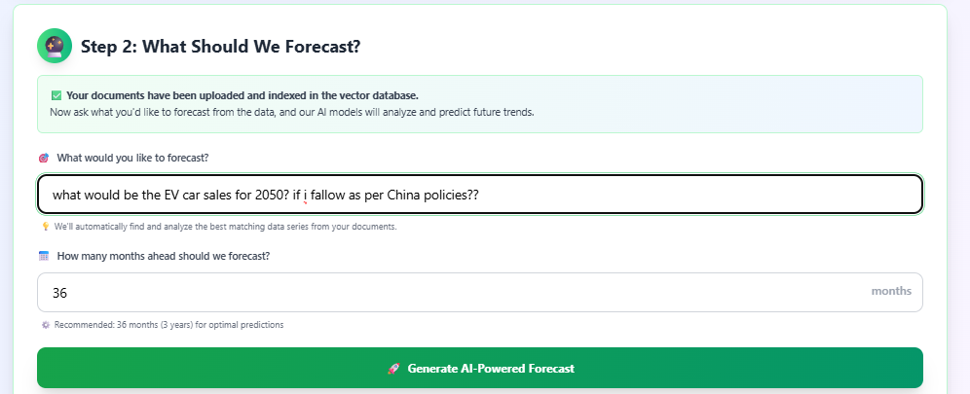
Ask Query

Slide 13
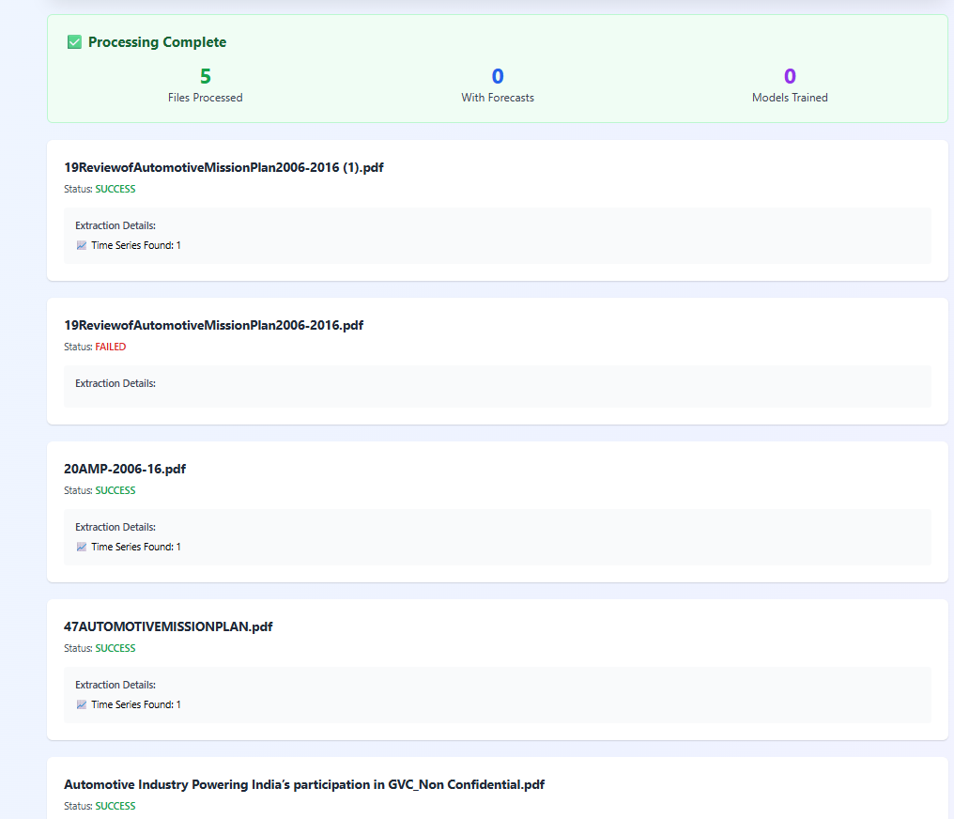

Slide 14
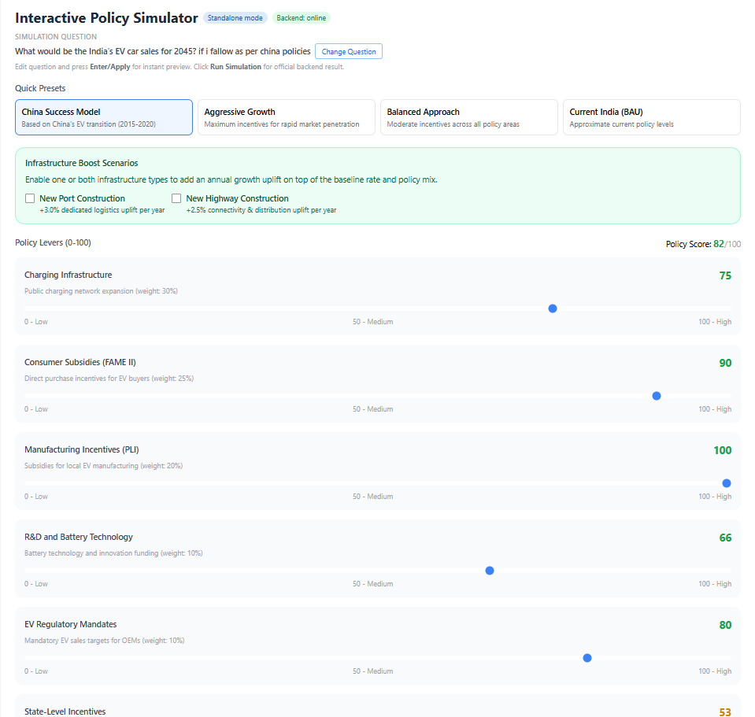

Slide 15
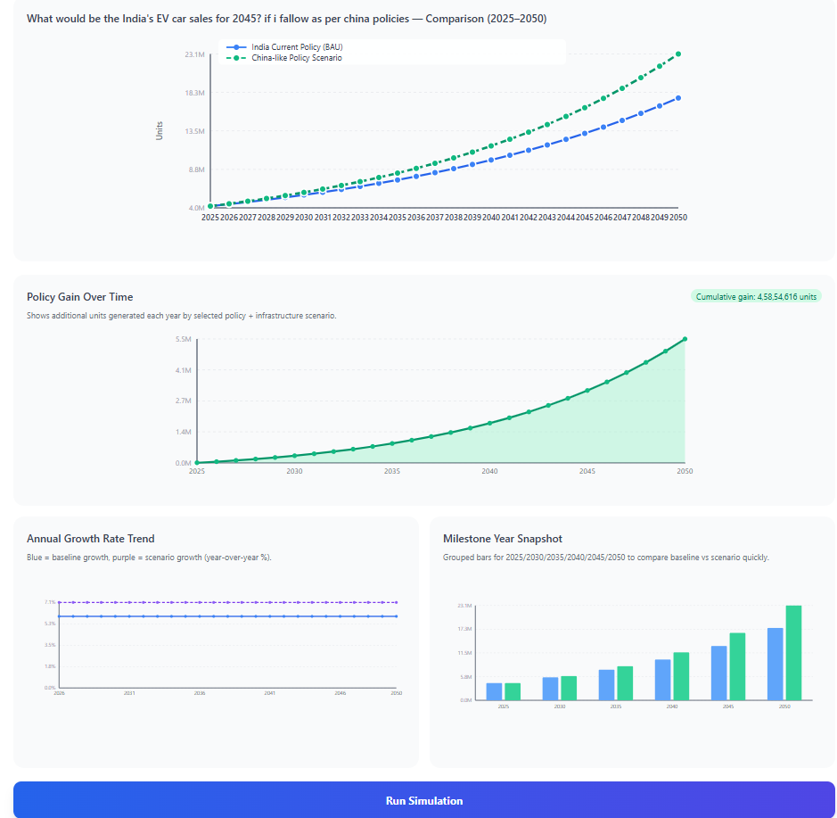

Slide 16
